Slide 1


Institut Sino-européen d’Ingénierie de l’Aviation 中国民航大学中欧航空工程师学院
Project Management Course
Session 1:
Project Management definition
Project Management

Slide 2
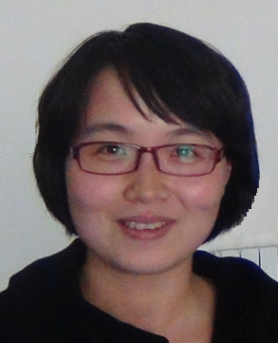
Background – Xiangping LI
Education Background
2005 Master Degree(NUAA) :
  Structural Strength and Fatigue
  Structural Optimization
Work Background
3 years Assistant Engineer:
  Turbine aeroengine; Rotor aeroengine
  Aircraft fuselage; wings; parts
  UAV developments
4 years System Engineer for Project:
  Many cases on developing aircrafts, including helicopter;
  ** aircraft development;
  ** helicopter development;
  ** rotor aeroengine development;
  Risk analysis and conflict solving
  Measure and control the projects
Other Training Experience:
  Internal Quality Auditor Training
  Project Management Training
  Matrix Organization Training
Education Background
2005 Master Degree(NUAA) :
  Structural Strength and Fatigue
  Structural Optimization
Work Background
3 years Assistant Engineer:
  Turbine aeroengine; Rotor aeroengine
  Aircraft fuselage; wings; parts
  UAV developments
4 years System Engineer for Project:
  Many cases on developing aircrafts, including helicopter;
  ** aircraft development;
  ** helicopter development;
  ** rotor aeroengine development;
  Risk analysis and conflict solving
  Measure and control the projects
Other Training Experience:
  Internal Quality Auditor Training
  Project Management Training
  Matrix Organization Training
Education Background
2005 Master Degree(NUAA) :
  Structural Strength and Fatigue
  Structural Optimization
Work Background
3 years Assistant Engineer:
  Turbine aeroengine; Rotor aeroengine
  Aircraft fuselage; wings; parts
  UAV developments
4 years System Engineer for Project:
  Many cases on developing aircrafts, including helicopter;
  ** aircraft development;
  ** helicopter development;
  ** rotor aeroengine development;
  Risk analysis and conflict solving
  Measure and control the projects
Other Training Experience:
  Internal Quality Auditor Training
  Project Management Training
  Matrix Organization Training
xpli1980@163.com

Slide 3
Project Management Course summary
Project Management
Session N°: TITLE:
TC 1 Project Management definition（2h）
TC 2 Project Phasing - Key success factors（2h）
TC 3 & 4 Organize and Plan the Project（4h）
TD 1 Make the WBS for the Project（2h）
Our aims
2W + 1H+ ready for Multidisciplinary Project

Slide 4
Project Management
Teaching Organization Form & Examination
Teaching form:
TCs + discussion+ TD+ exercises
Examination:
Attendance 10%
Behaviour on course (individual) 40%
Project Application (by group) 50%

Slide 5
Project Definition
Project Management
10 Minutes Exercise:
What is your definition of “Project”?
(Individual or group definitions)
Can you give us some Project Examples ?

Slide 6
Project Examples
Project Management
Note: Project & Programme
According to PMI (Project Management Institute): synonymous words.
In USA: A Programme is longer and includes several projects
  Example: A 380 is a Programme; development & certification of A380 is a Project
In French: Projet = proposition Programme = contract

Slide 7

Project Management
Project Examples

Slide 8
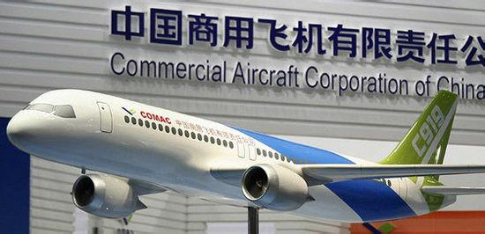
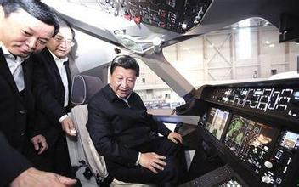

Project Management
Project Examples

Slide 9
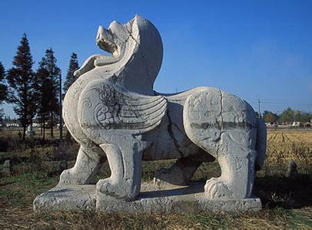


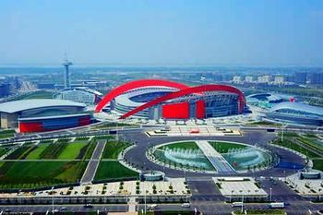
Project Management
Project Examples

Slide 10


Project Management
Project Examples

Slide 11
Project Management
Project definition
According to PMI: A project is a temporary endeavor undertaken to creat a unique product, service or result;(旨在提供独特的产品、服务或成果临时性的努力)
We suggest: Project = Bid + Programme
E.g.
Establish a reservior, a bridge, a building;
Supply new product, new software
Organize celebration activities, and meetings
Research project
Others

Slide 12
Project Management
Specifications of a project
The exact starting and ending time(明确的起止时间)
The exact definition of the final goal(明确的目标)
Only one time (只发生一次)
Including Time, Quality and Cost (时间、质量、成本)
The exact result (明确的结果)
Full of risk (充满风险)

Slide 13

Project Management
Note: Project & Operations
Importance：All the project specifications MUST be 100% satisfied

Slide 14
Project Management
Which one is project?
Repair a car
Develop a new product
Interview applicants
Produce telephone
Design a new curriculum
Modify the software to satisfy customer
Use a new software
Build a house
SIAE

Slide 15

Project Management
Project definition
在当今社会中，一切都是项目，一切也都将成为项目
美国项目管理专业资质认证委员会主席
Paul Grace

Slide 16
Project Management Definition
Project Management
What is called Management
A person, or a group, or a team who is able to set up the confirmation of the “Goal” to the utilization of the “Resource” through the different tools of the “Plan”& “Supervision” in order to achieve the final satisfied “Result”.

Slide 17
Project Management Definition
Project Management
“Project Management” is the combination of methods, tools for evaluation, planning & organisation, in order to reach the objectives of the project, while respecting the constraints of performance, delivery time and cost, using the resources available. (Hard)
“Project Management” is also the capacity to manage a team, to co-ordinate and to obtain co-operation from specialists with different skills. (Soft)

Slide 18
Project Management
Project Management Definition
Specifications of Project Management
Treat the variety, complicated
System engineering, Science & Art
Creative & specialty
Discipline&Major&Career (manager is very important, PMP)
Concept & Method
Strategic curriculum

Slide 19
Project Management
Case discussion 1
Mike’s Confusion
Background:
Mike was a very excellent student in university;
Good academic knowledge.
Mike also behaviour excellent as a structural engineer in recent 3 years;
Mike was asked to modify one certain type aircraft to exhibition within 3 months

Slide 20
Project Management
Case discussion 1
Mike is confused now:
How to start the work?
Whether he and his team can finish the task in time?
How to encourage his members?
How to ensure the quality of the aircraft?
How to ensure the project not out of control?
How to cope with risks?
Above all are not only technique questions!!

Slide 21
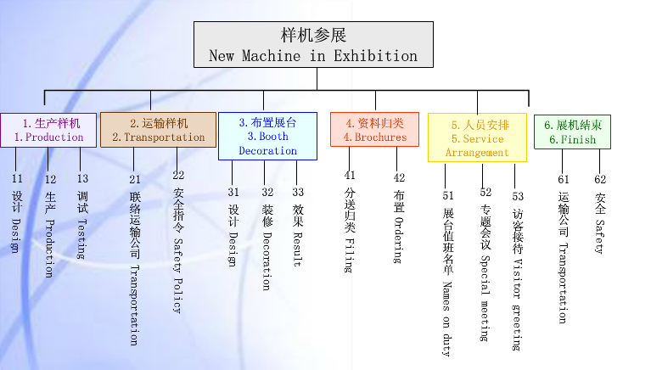
Project Management
Case discussion 1

Slide 22
Project Management
Case discussion 2
New teacher questions
How to apply for projects funded by National Natural Science Foundation ?

Slide 23
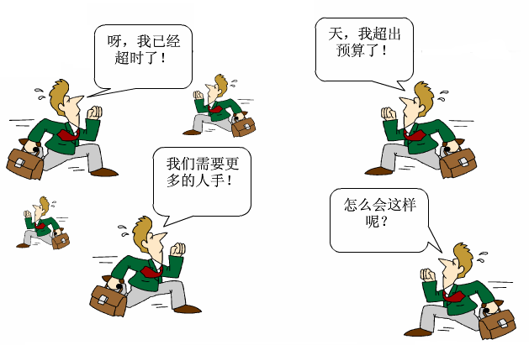
Project Management

Slide 24
Project organisation: the basic triangle!
Project Management
The 3 parameters to strongly monitor in Projects:
Performance, quality:
  Usually, the first topic addressed.
  Performances, as required by the Customer technical specification
  Quality, as required by the Customer contract / standards, the international standards (ISO 9001…) and the Company standards.
  Higher performance / quality impacts costs; lower is not acceptable!
Delivery time:
  Usually, specified in Contract (after negotiations)
  To be strongly monitored in Project management: WHY?
  Delivery time is strongly related to cost: WHY?
Cost:
  The first concern of Company Management & Customer!
  Exercise: What is the difference between COST and PRICE?

Slide 25
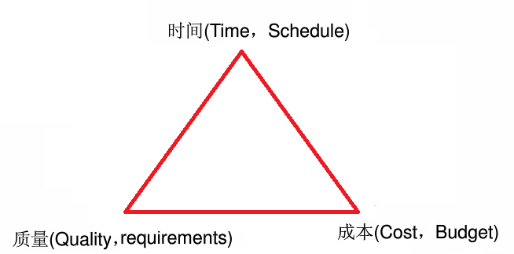
Project Management
Project organisation: the basic triangle!

Slide 26
Project organisation: the basic rules!
Project Management
The 2 basic rules to implement in Projects:
Organise and Plan:
  The first phase to be addressed.
  Organise: System design, WBS / OBS,team, resources…
  Plan: Detail specifications & planning, including links
Monitor and Control:
  Essential to get good results for the basic triangle.
  Monitor: Measure achievements, planning, costs
  Control: the implementation of tasks, the risks…
To be detailed later in the course!
Note: COST:
PRICE:

Slide 27
Project or Production organisation?
Project Management
Production organisation:
  Traditional organisation of large companies
  Adequate for delivery of (large) number of (identical) equipment
  From Cars to Radars: other Examples?
  Benefit: low cost , quality, traditional organisation in specific jobs…
  Lack of flexibility in the Design & Development!
  Organisation in Departments: Design & Development, Quality…

Slide 28
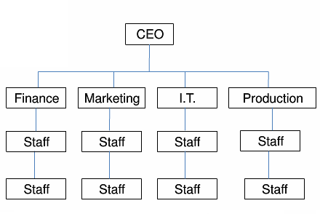
Project or Production organisation?
Project Management

Slide 29
Project or Production organisation?
Project Management
Project organisation:
  Organisation for specific needs; System matched to a Customer
  More and more applied in large companies for large Systems
  Benefit: matched to Customer demand, to Operational needs
  Drawbacks: more complex management, generates conflicts!
  Organisation with a dedicated Project team, and transverse relations.

Slide 30
Matrix organizational structure
General
Manager
DEPARTMENTS
Administration
& H.R.
Engineering
Operations
Marketing
& Sales
Quality
SERVICES
SECTIONS
Software
Purchasing
Hardware
Production
Project
Management
A
B
Customer
Services
Up
stream
Down
stream

Slide 31
Project Management
  Discussion: winning projects
  Satisfied customer/user
  Finished on time
  Not excess budget
  Ensure the quality

Slide 32
Project Management
  Discussion: Why projects fail?
  Lack of user involvement
  Incomplete requirements & specifications
  Change of requirements & specifications
  Lack of executive support
  Technology Incompetence
  Lack of resources
  Unrealistic expectations
  Unclear time frames
  New technology

Slide 33
The first winning Project in History:
The great pyramid of Cheops
Project Management
- Feasibility study: “During first & second years of Pharaon reign, the large parts of the pyramid construction work were defined; a rough pre-project was made, some drawings were designed. A first estimate of manpower, materials, equipment was made. In summary, all main parameters were defined, in order to check they were realistic”.
- Budget control: “A budget control was made, with multiple accounts. On one side, global accounts including the number of day-work and corresponding number of meals; on the other side, the number of workers,with their name and the actual number of work-hours; finally, the organisation in teams.”

Slide 34
Other winning Project examples in History:
Project Management
1) Standardization in Roman empire:
The Roman road is famous for its high resistance, due to its structure. Roman people constructed in their empire a large network of roads, enabling the administration and the military control of their empire. It included 90 000 km of main roads & 200 000 km of secondary roads. It enabled a large economical development of the Roman empire.
2) Budget control in Greece:
“In Greece, architects were obliged to implement their works for the price they have quoted before. When the work was completed, if the actual cost was inside the prevision, they were awarded and honoured in public. If the actual over-cost was not more than 1/4th of the prevision, it was paid by the public budget. If the over-cost was more than 1/4th , the excess was born by the architects!”

Slide 35
One losing Project example in History: the first Panama channel.
Project Management
Taking advantage of his great popularity, following the success of the Suez channel, Ferdinand de Lesseps started the work on the first Panama channel in 1880. Great technical difficulties and the impact of the local climate (malaria & yellow flew) led to bankrupt and stop of the project in 1889. Americans re-started the second channel project in 1904, on the basis of a different concept, for an inauguration in 1914.
The Panama channel is an example of a technical concept/design not matched to the actual constraints: the first choice was a “level channel” as for Suez; when it became obvious that this choice was a mistake (actual profile of the terrain), Lesseps asked Eiffel to build dams, but it was too late to save the project. Americans started directly with the second concept, an advantage of previous mistakes.
The feasibility study should have taken into account the actual geographical / geological constraints, as well as the local climate.

Slide 36
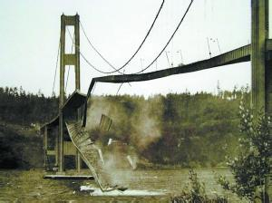
Other losing Project example in History:
Tacoma Narrows Bridge
Project Management

Slide 37
Project Management
  References:
  [1]Harold KERZNER, Project Management: A Systems Approach to Planning,Scheduling,and Controlling [PhD Thesis]. Baldwin-Wallace College in Ohio (America)
  [2] A Guide to the Project Management Body of Knowledge( PMBOK Guide), Project Management Institute (America)

Slide 38
Project Management
荀子的《劝学》：
“吾尝终日而思矣，不如须臾之所学也；吾尝跂而望矣，不如登高之博见也。登高而招，臂非加长也，而见者远；顺风而呼，声非加疾也，而闻者彰。假舆马者，非利足也，而致千里；假舟楫者，非能水也，而绝江河。君子生非异也，善假于物也。”
我们不能将明天简单的理解为只是今天的延续
应对变化的能力是第一能力

